Slide 1
Higher Education Policies:
Challenges and Opportunities
Prof. David Taylor
Pro Vice-Chancellor (International)

Slide 2
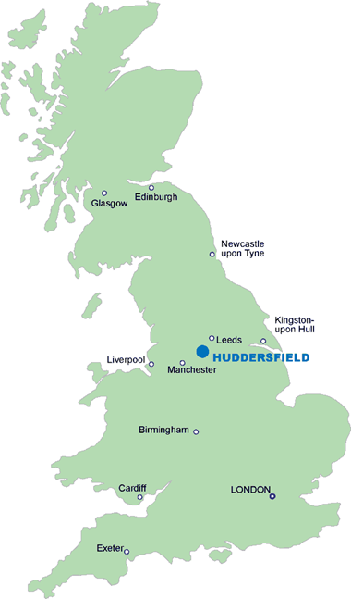
University of Huddersfield
22,000 students from over 120 countries
Times Higher Education University of the Year 2014
Times Higher Education Entrepreneurial University of the Year 2012/13
Queen’s Award for Enterprise 2013 (only University)
Inaugural Guardian Inspiring Leader Award
Strong existing links with Libya

Slide 3
University of Huddersfield
Long and successful relationship with Libya
More than 100 Libyan students on campus
Mostly science and engineering PhD students

Slide 4
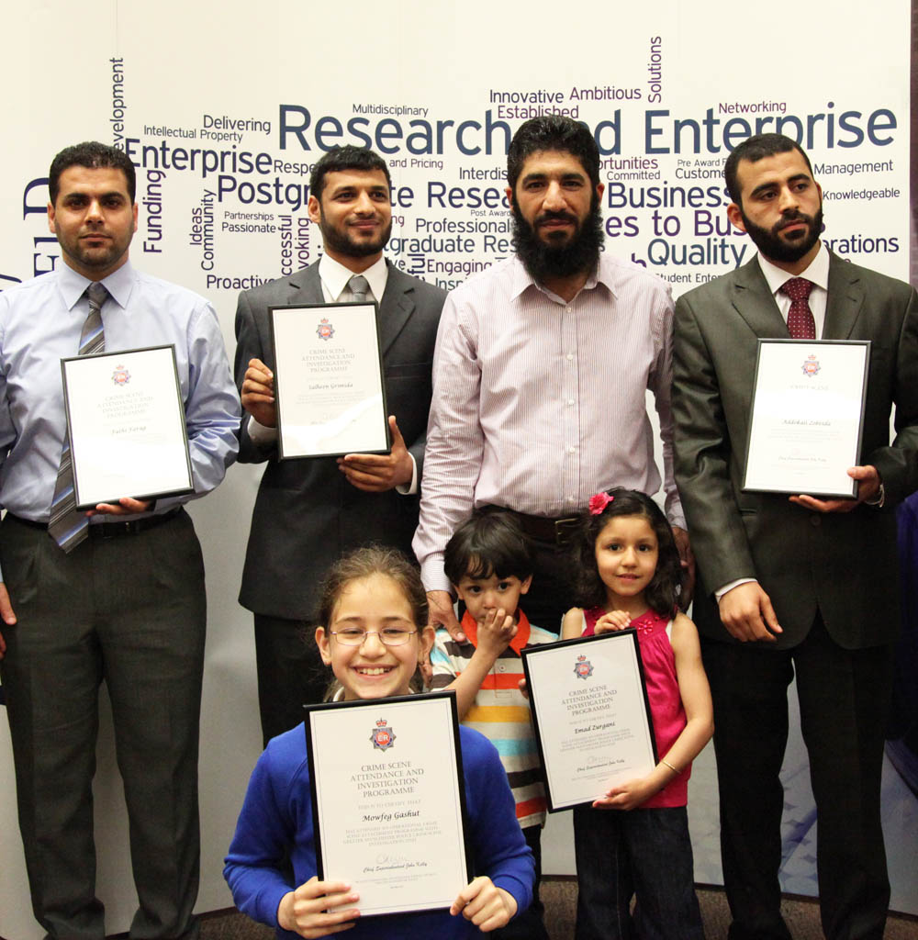
Why so many?
Travel to Libya to understand needs
Extensive English language provision
Family-friendly

Slide 5
University of Huddersfield
Our Libyan students
Take an active part in campus life
One of our most active and friendly student societies
Sharing their culture with others

Slide 6
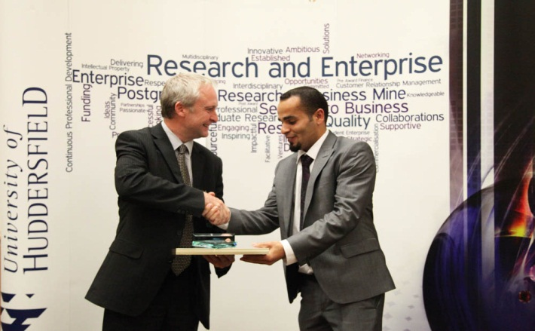
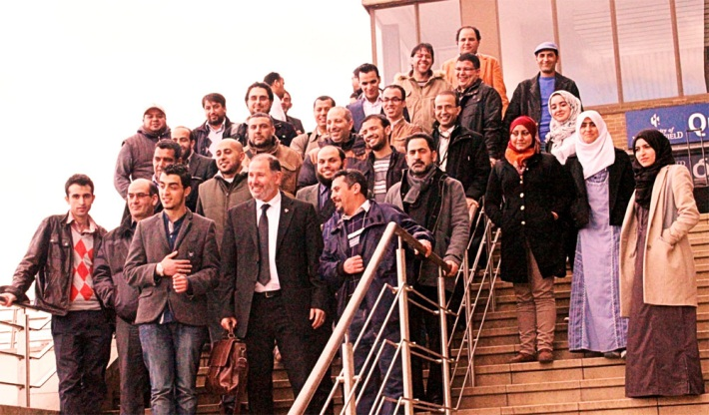
University of Huddersfield
Our Libyan students
Are some of our highest achieving
And the best supported by their Embassy

Slide 7
HE Policy: Public Funding for HE
Challenges
Who pays?
What is the right level of public funding
What is the right level of private funding
UK anticipate 55% being paid back
Investment or subsidy?
Huddersfield
University run like a business
No long term debt
Number one for financial sustainability
Opportunities
Share approach and philosophy

Slide 8
HE Policy: Student experience
Challenges
Assurance over standards
QAA, Professional Bodies, External Examiner system
Assurance over experience
Staff quality
National student survey
Student employability
Huddersfield
Full QAA confidence, over 40 Professional Body Accreditations
Only University to have 100% Fellows of Higher Education Academy
Top 10 for key aspects of National Student Survey
Top 10 over last 3 years for student employability
Opportunities
Share our Learning & Teaching strategy and approach

Slide 9
HE Policy: Research
Challenges
Funding
Dual, concentration, de minimis?
Impact
How to measure and encourage translation of research
UK most efficient & productive in G8
14% of top global papers
Huddersfield
Strong science and engineering research base
One of the ten National Centres of Excellence for Advanced Manufacturing
Agilent European Centre of Excellence in analytic chemistry
Tripled research numbers and doubled research income in 5 years
Opportunities
PhD study and collaborative research

Slide 10
HE Policy: Social mobility
Challenges
Raising aspirations in poorer communities
Raising attainment in Schools & Colleges
Raising attainment
Securing jobs
Huddersfield
Top 10 for social inclusion
Engage with and support regional Schools and Colleges particularly in terms of governance
Developed a predictive analytics approach to focus support
Target of 100% of students gaining industrial experience
Top 10 for jobs – real social mobility
Opportunities
PhD study and collaborative research

Slide 11
HE Policy: Globalisation
Challenges
Developing a global workforce
UK 2nd only to US in terms of international students
International student and staff are vital as want to attract best in the world
Huddersfield
Students and staff from over 120 countries
Top 10 in International Student Barometer
Queen’s Award for Enterprise
QS 5* for Internationalisation
Opportunities
Staff development and training
Joint research
MSc and PhD

Slide 12
HE Policy: Innovation & Growth
Challenges
How can Universities stimulate local innovation & growth
Higher Education Innovation Fund
Local Enterprise Partnerships
Huddersfield
Entrepreneurial Uni of the Year
3M Buckley Innovation Centre
Global CEOs. Fortune 500
Access to Technology, Markets & Finance
Work closely with region
Opportunities
Share regional engagement models

Slide 13
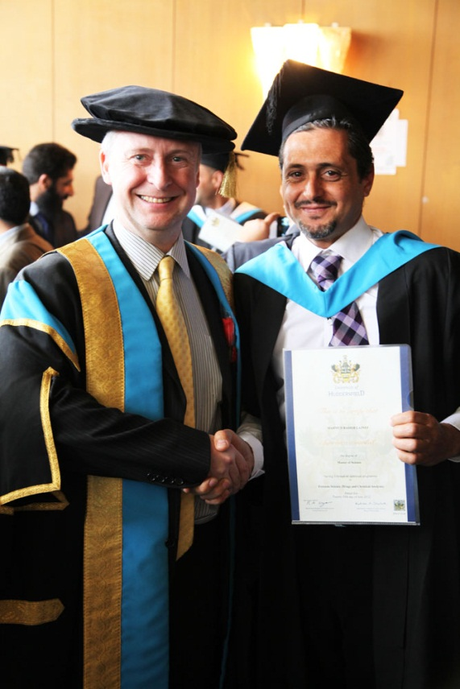
Conclusion
Huddersfield is proud of its links with Libya
We value your contribution to our University and look forward to developing further opportunities

